Slide 1
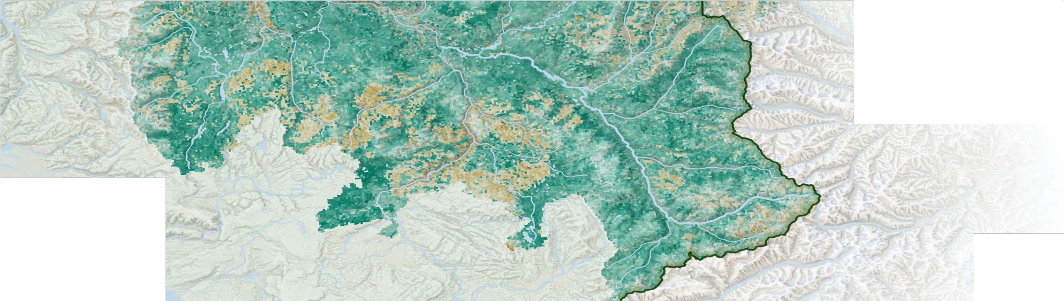


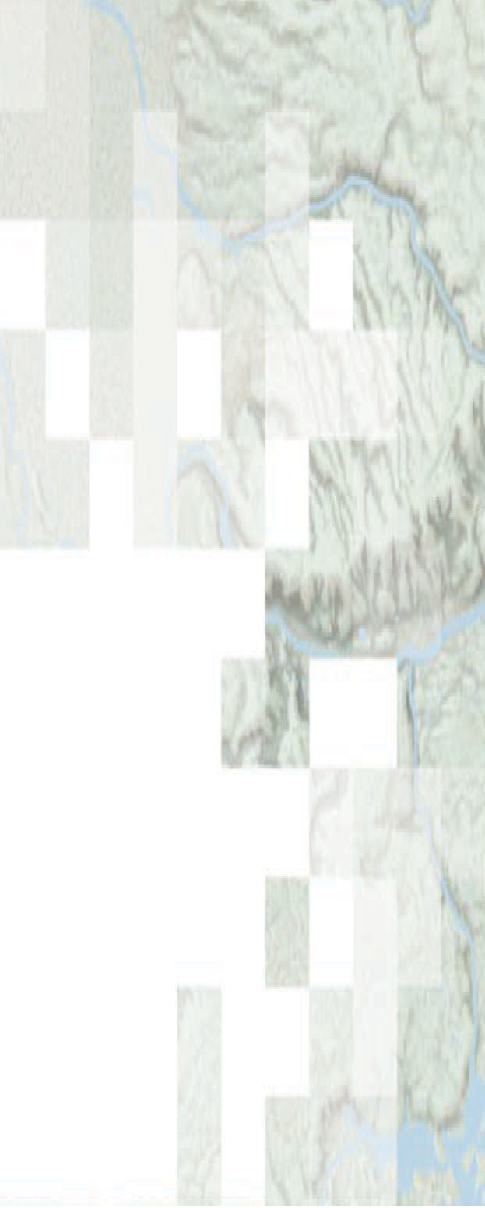


!"#$%&"' )*+%&",#$-. "&/ 01"-* )/2$&$.#+"#$%&
The ITCOocean hack2week content includes slides from NASA ARSET. Slides without the NASA logos were prepared by Eli Holmes (NOAA) and those with the NASA logos are from ARSET.
Species Distribution Modeling with Remote Sensing
Amber McCullum, Juan Torres-Perez, Zach Bengtsson
Aug 12, 2021

Slide 2
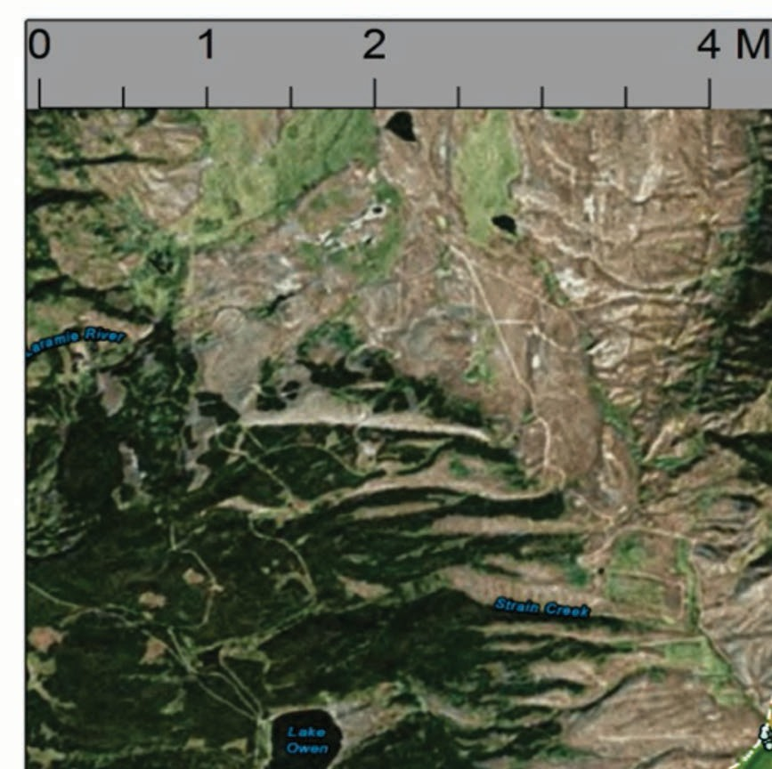
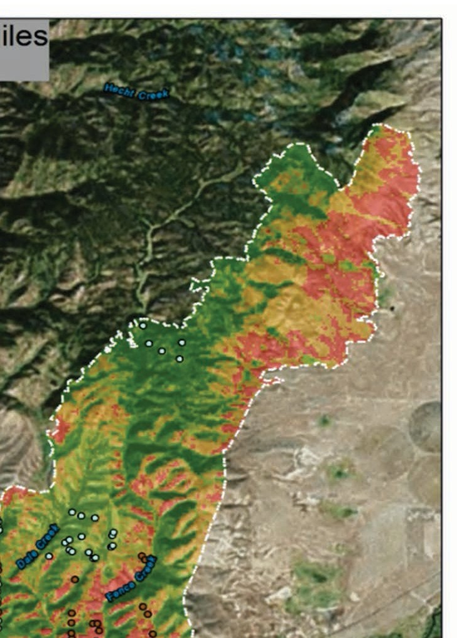
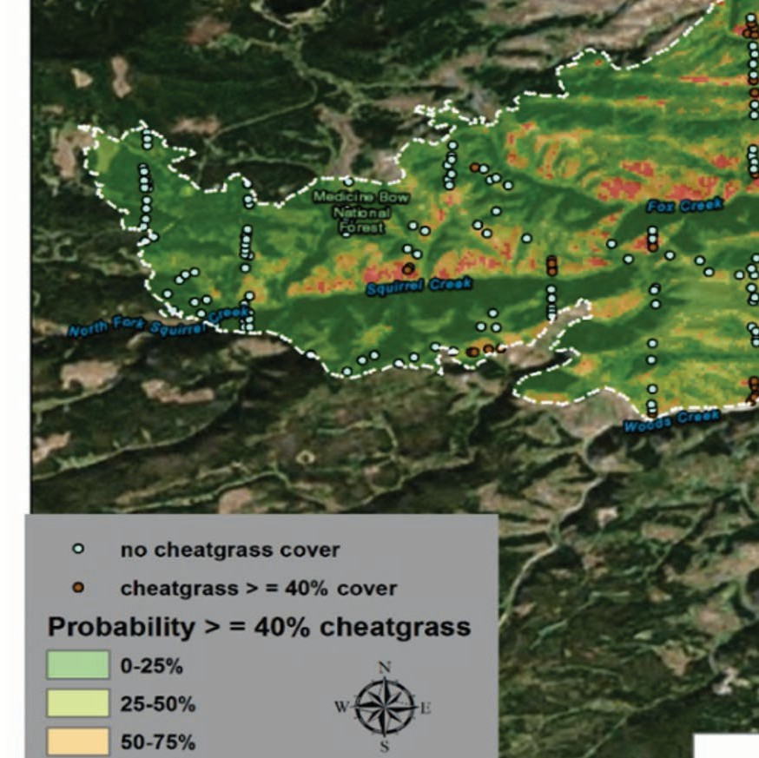
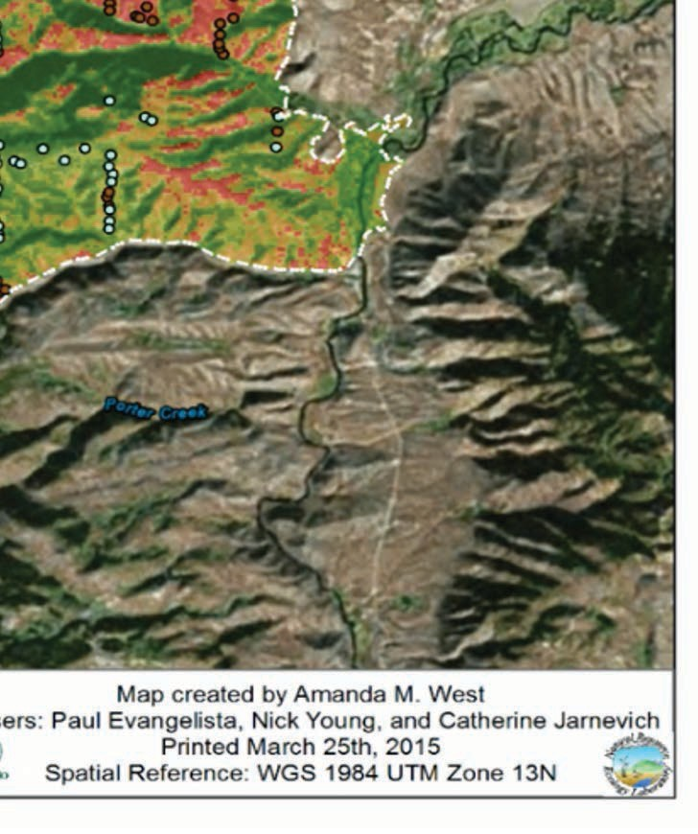
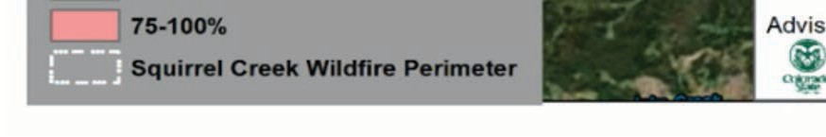
SDM Overview
Week 1 – SDM overview
Species Distribution Models (SDMs) overview
Occurrence data – IndOBIS by Johnny Konjarla
SDM environment data overview
Application lecture by Ben Best
More occurrence data
Week 2 – SDMs in R
Occurrence Data
Environmental Variables
Methods and Models
Case Study Examples
Question and Answer Session
ARSET image
4

Slide 3
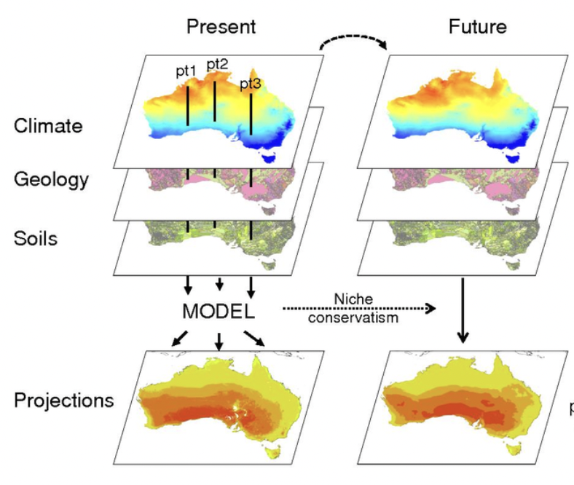
”Species” Modeling
For the techniques we are learning, we are learning “species” does not have to mean species (living organism).
Presence (0/1) observations of something with location and time
Density, count, value observations also work

Slide 4
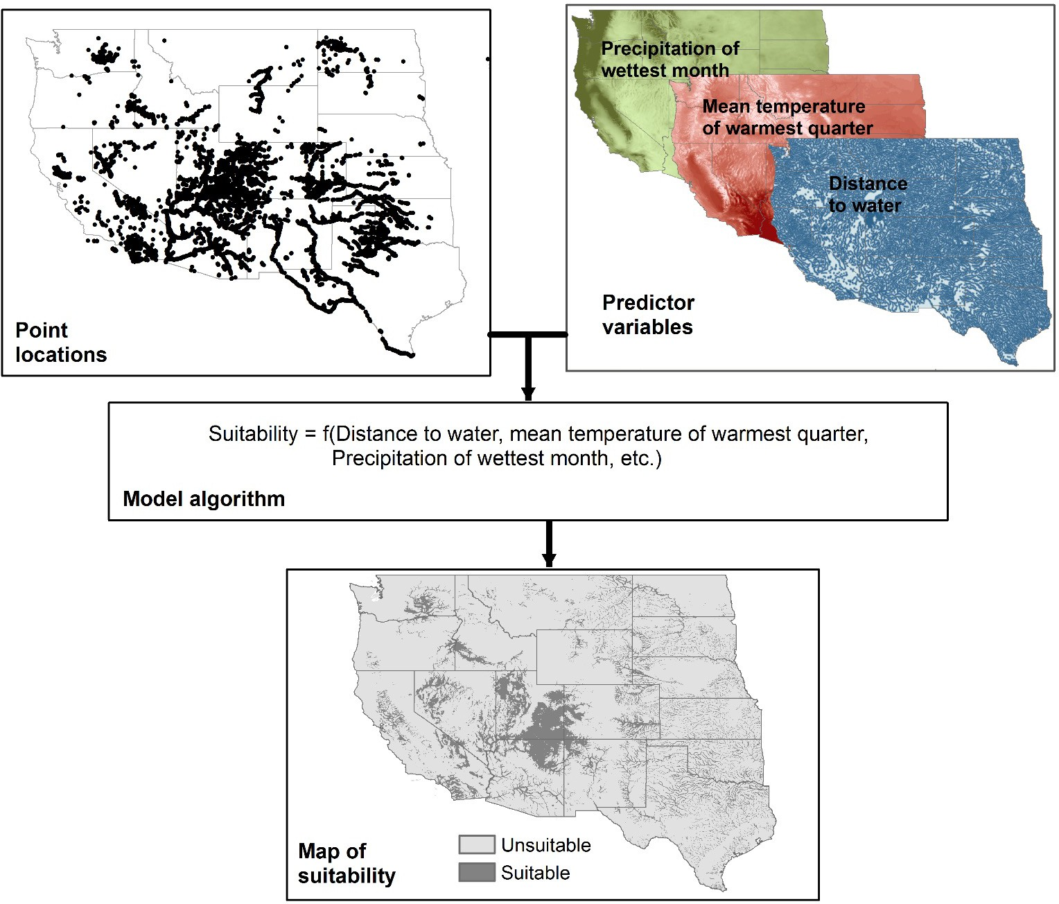
Environmental Variables

Slide 5
Climate Variables – this is a science step
What are the drivers of ecological processes?
Temperature
Salinity
Bathymetry
Eddies
Phytoplankton
Upwelling zone
….
Scenario modeling
Use of climate change models for predicting future habitat

Slide 6
Marine Climate Variables
For the hack2week
sdmpredictors R packages: a large suite of global marine environmental predictors and future conditions. STATIC (mean over years)
Indian Ocean Zarr file. For dynamic (daily) gridded variables. Prepared by Minh Phan. In our shared drive. Needs to be access with Python.
Indian Ocean CMIP6 Zarr file. Future scenarios. Prepared by Minh Phan. In our shared drive. Needs to be accessed by Python.
Other sources
Many many different types of relevant variables from oceanography and marine biology
We’ll look at the ARSET slides from the land SDMs for inspiration.
A possible hackweek project would be developing the needs for Indian Ocean SDM environmental variables and come up with a plan (data storage, package, API?) that could be deliver that to the community.

Slide 7
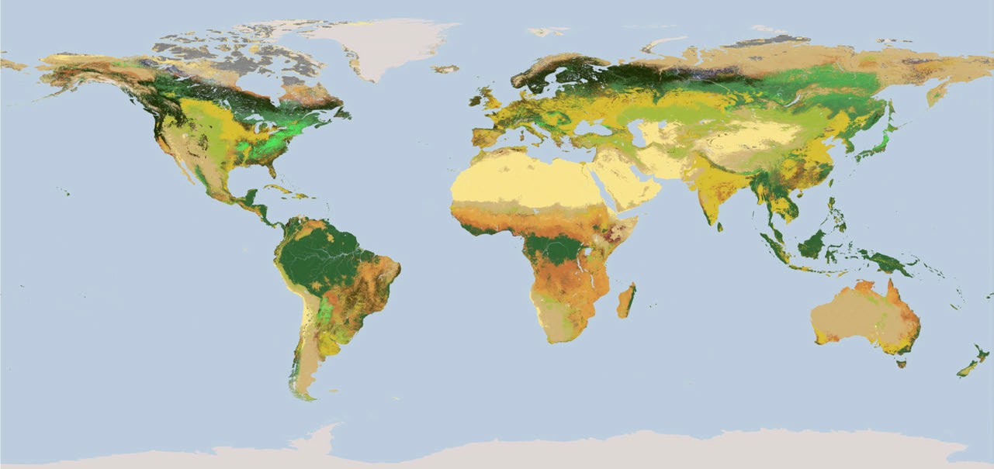
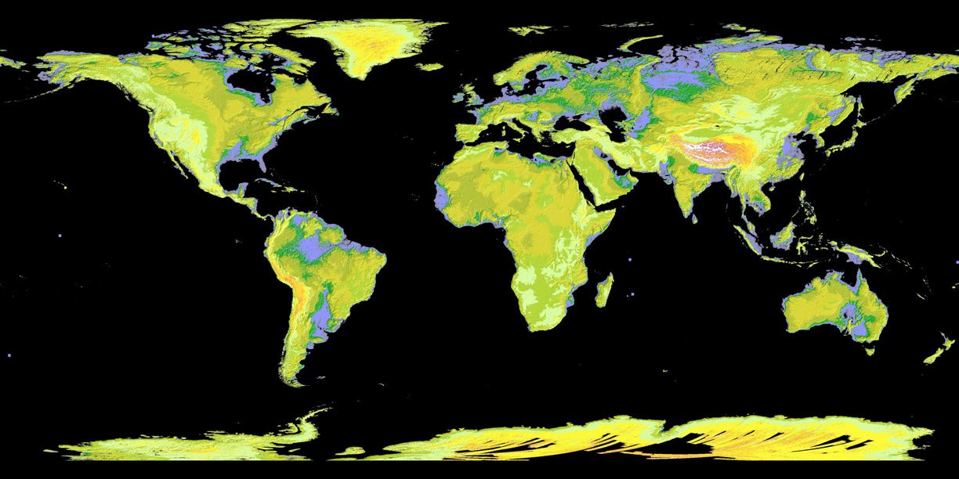
Environmental Variables - Land focused
Land Cover
Phenology
Vegetation Indices and Fractional Cover
Tree Mortality (insect/disease)
Topography: Elevation, Slope, Aspect
Climatology: Temperature (min., max., mean, etc.), Precipitation (min., max., etc.)
MODIS Land Cover Product
ASTER Digital Elevation Model (DEM)

Slide 8
Land Cover and Species
Land cover is one of the most important drivers of biodiversity.
It affects patterns of species diversity, distributions, and ecological processes.
Accurate land cover maps are essential for SDMs.
" Land cover changes can dramatically affect species distributions.
Many regional and global land cover maps are available.
Creating your own land cover maps with ground-based data is ideal.

Slide 9
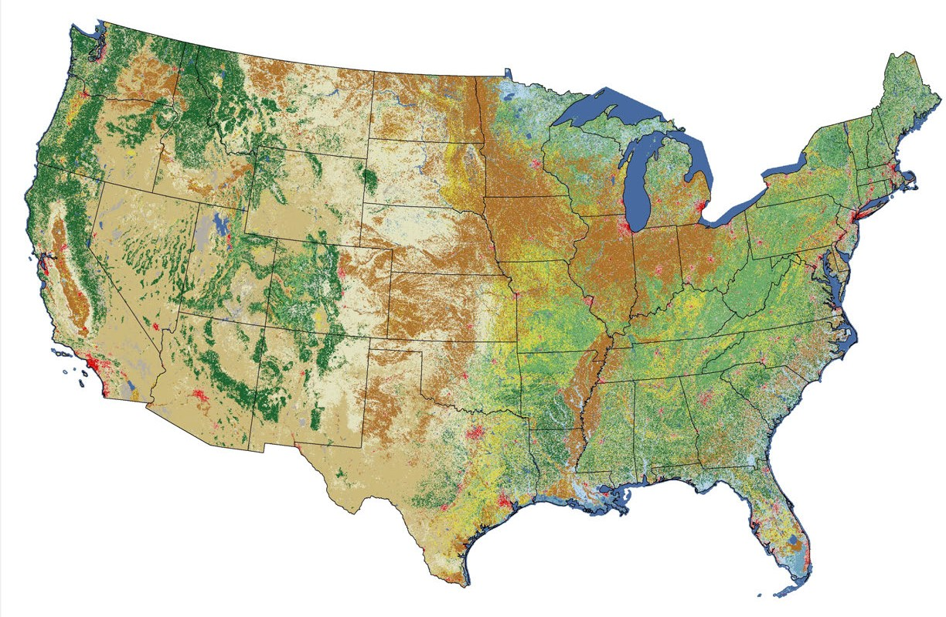
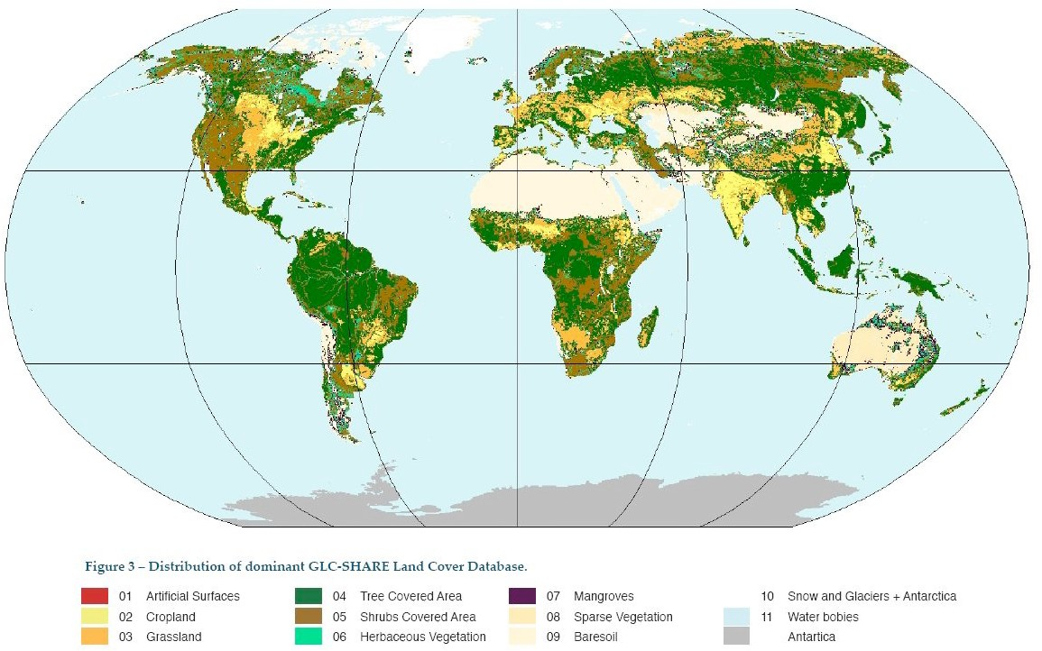
Environmental Variables: Land Cover Products
United States:
National Land Cover Database (NLCD)
GAP Analysis
LANDFIRE
Global:
MODIS Land cover product
FAO Global Land Cover-SHARE
ESA Climate Change Initiative Land Cover
National Land Cover Database 2011
FAO Global Land Cover

Slide 10

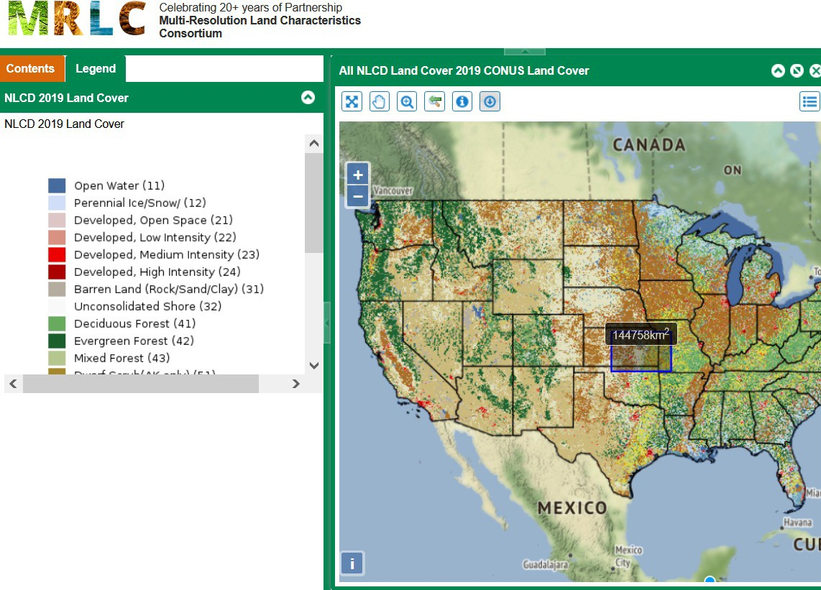


Multi-Resolution Land Characteristics (MRLC) Consortium
https://www.mrlc.gov
MRLC Interactive Viewer
National Land Cover Database (NLCD)
Landsat-based, 30 m resolution
16 land cover classes
2001, 2006, 2011, 2013, 2016, 2019
Other products include:
" Percent Tree Canopy (2011, 2016)
" Impervious Descriptor (2001, 2004, 2006, 2008, 2011, 2013,
2016, 2019)
Multiple interactive viewers for land cover, rangeland metrics, and advanced analysis
NASA’s Applied Remote Sensing Training Program
United States 17

Slide 11
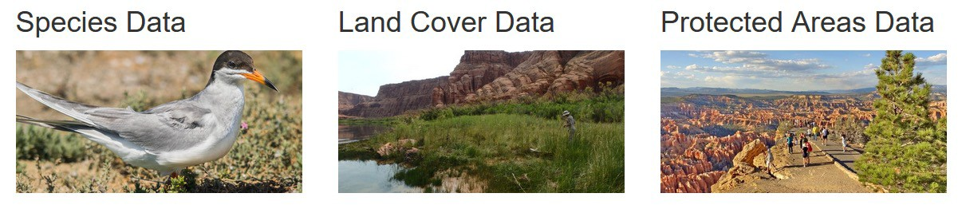
Gap Analysis Project (GAP)
https://www.usgs.gov/core-science-systems/science-analytics-and-synthesis/gap
United States Geological Survey (USGS)
Data and analysis tools for species, land cover, and protected areas
" Species range
" Additional data (land cover, forest edge, human impact, slope, aspect, canopy cover, etc.)
Land cover maps for U.S. that incorporate the Ecological System classification from NatureServe
NASA’s Applied Remote Sensing Training Program
18

Slide 12
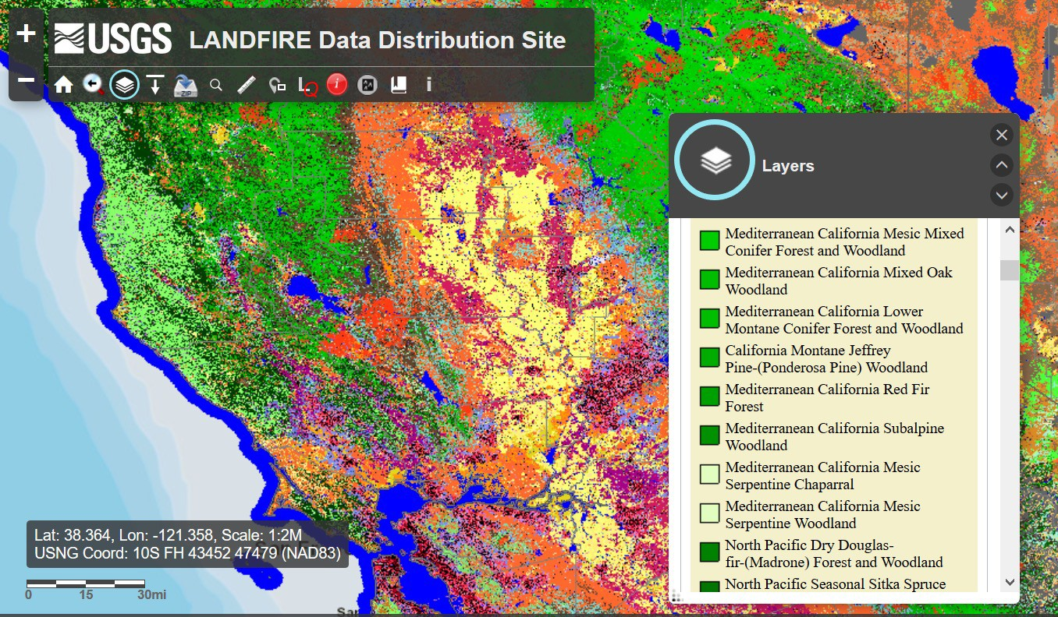
LANDFIRE
Recent ARSET Fires training: https://appliedsciences.nasa.gov/join- mission/training/english/arset-satellite-observations-and-tools-fire-risk-detection-and
http://www.landfire.gov
Products:
" Delivered at 30 m spatial resolution
" Available from 1999-present
" For the US only
Vegetation Data Layers using Landsat Imagery:
" Plant communities via NatureServe’s terrestrial Ecological Systems Classification, through 2016
Mapped with models, field data, and Landsat
Vegetation layers via LANDFIRE. Image Credit: https://www.landfire.gov/viewer
Disturbance Data:
" Fuel, vegetation, natural, and prescribed disturbance by type and year
NASA’s Applied Remote Sensing Training Program
United States 19

Slide 13
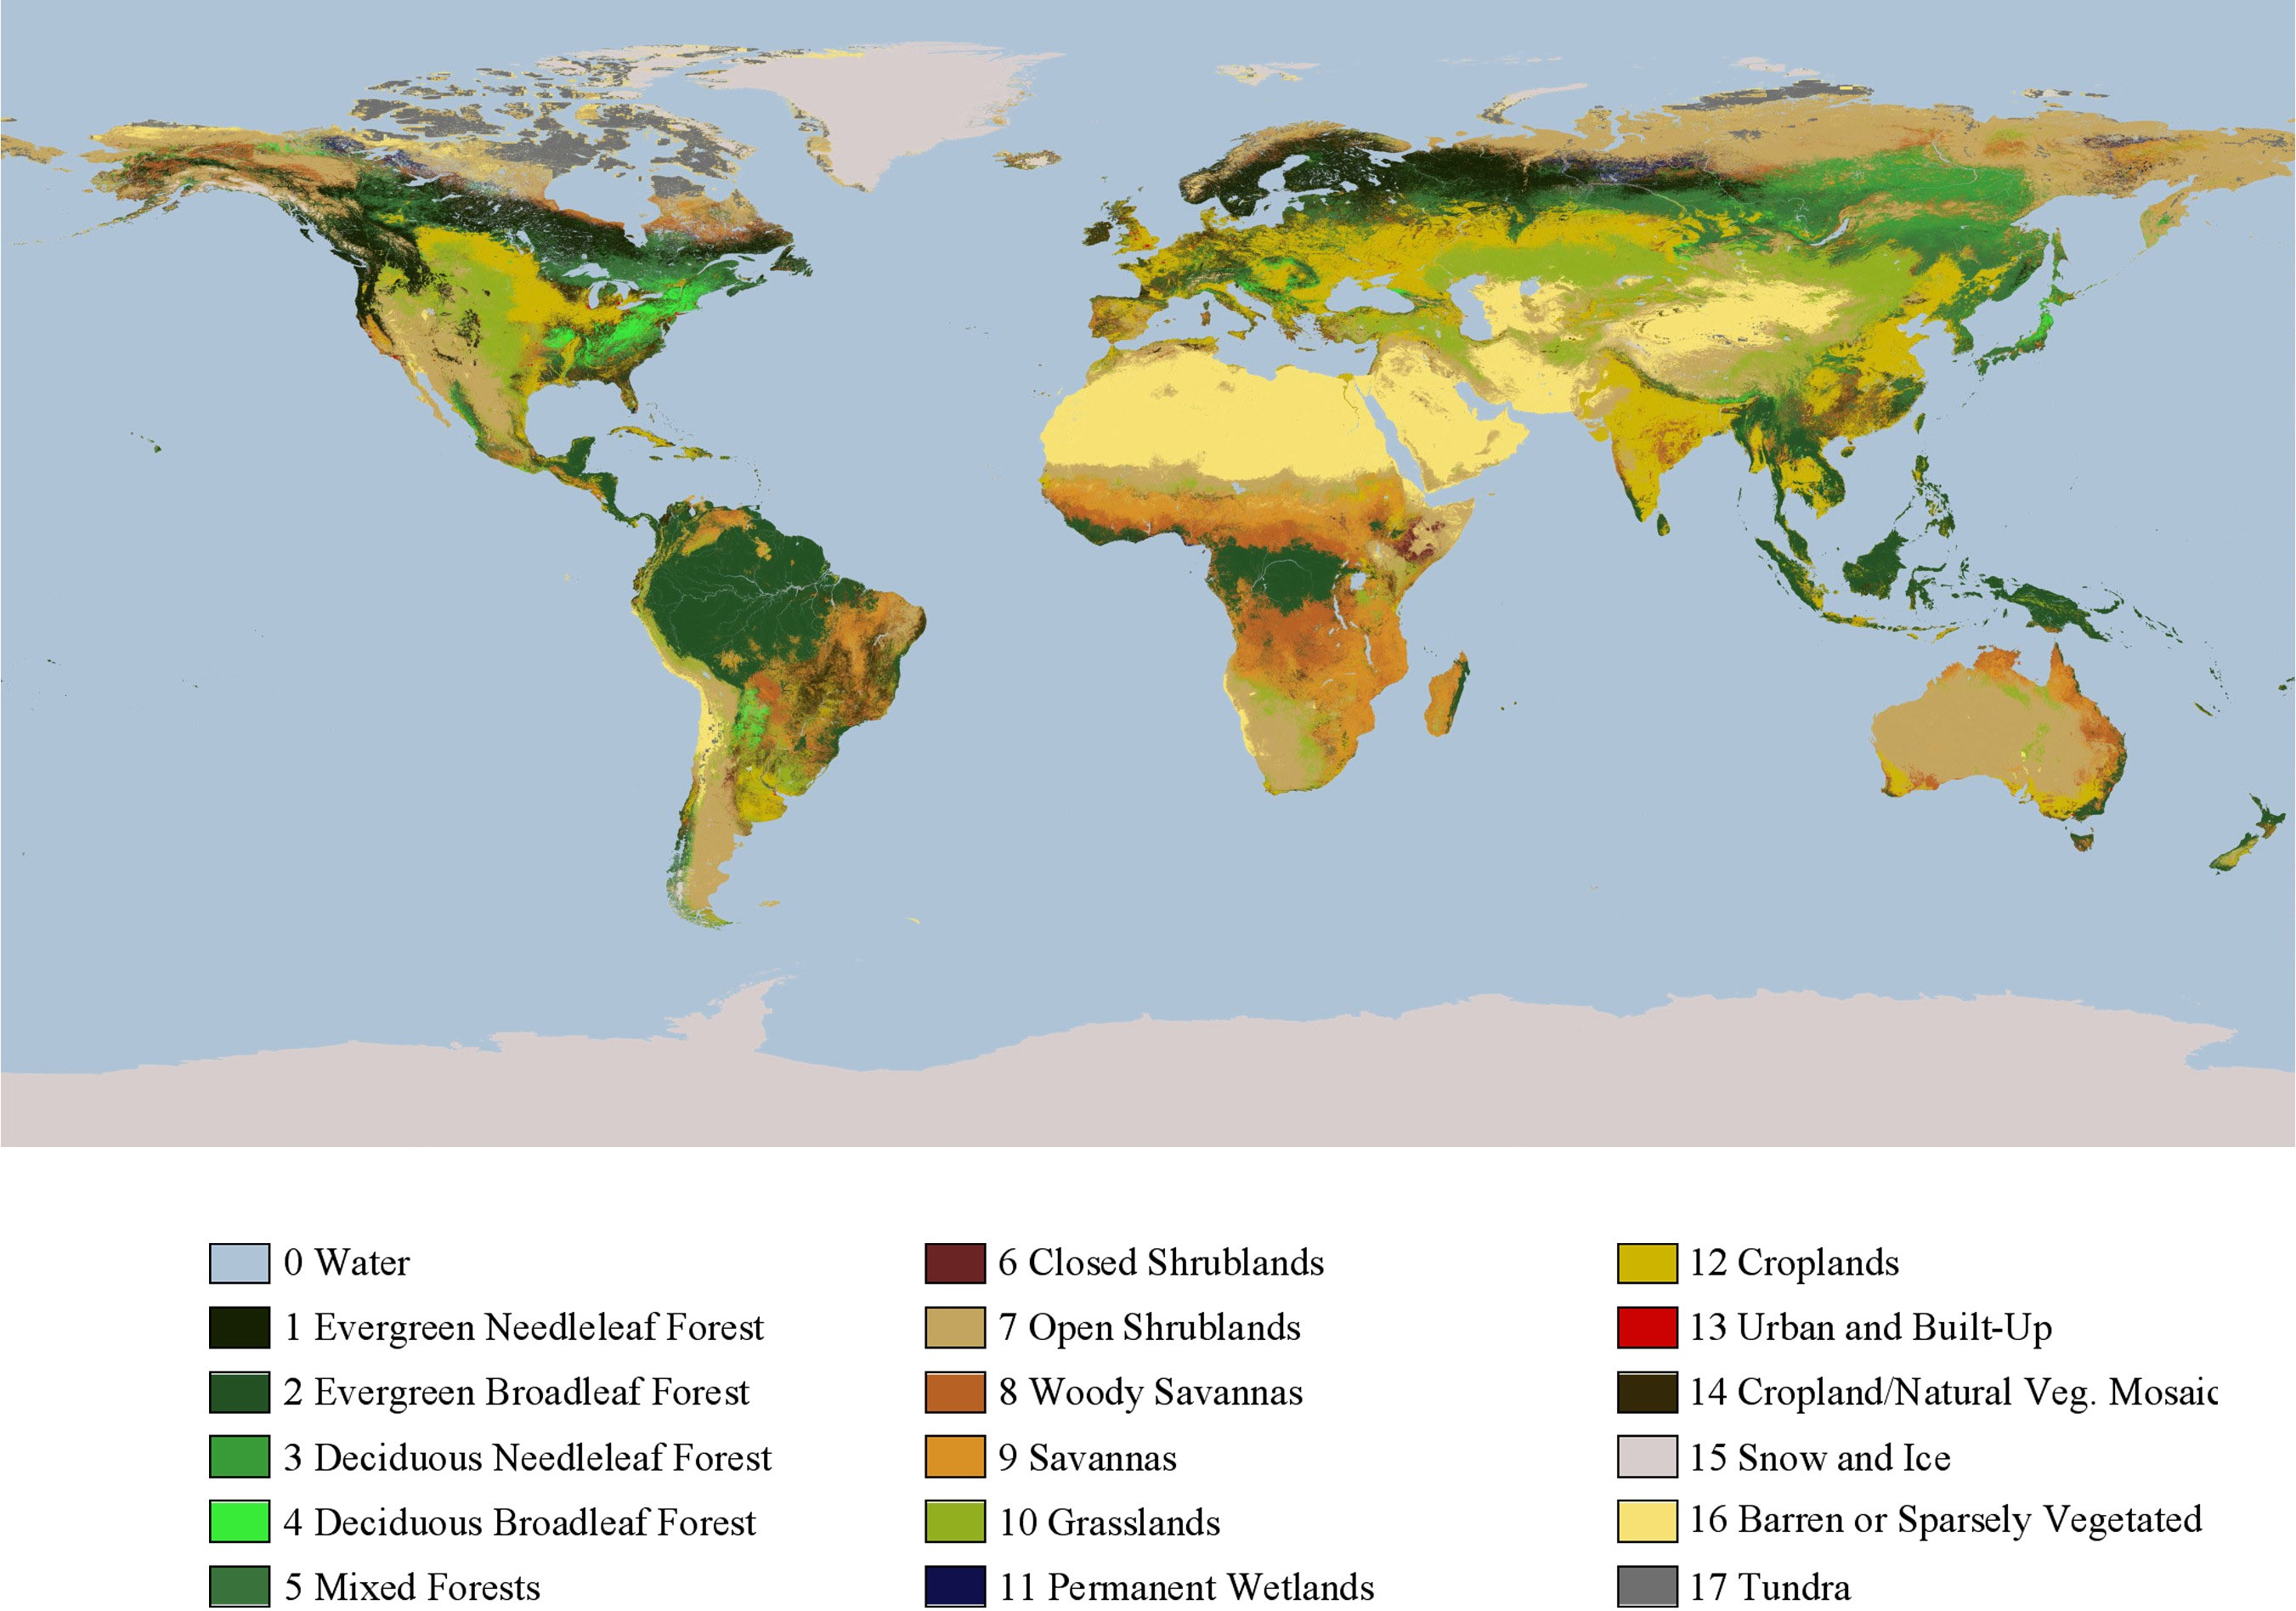
MODIS Land Cover
Contains 5 classification schemes
" Identifies 17 land cover classes identified by the International Geosphere Biosphere Programme, which includes 11 natural vegetation classes, 3 developed and mosaicked land classes, and 3 non- vegetated land classes
Spatial Resolution: 500 m
Temporal Coverage: 2001 – 2019 annually
Download data from NASA’s Earthdata Search: http://search.earthdata.nasa.gov
Global

Slide 14
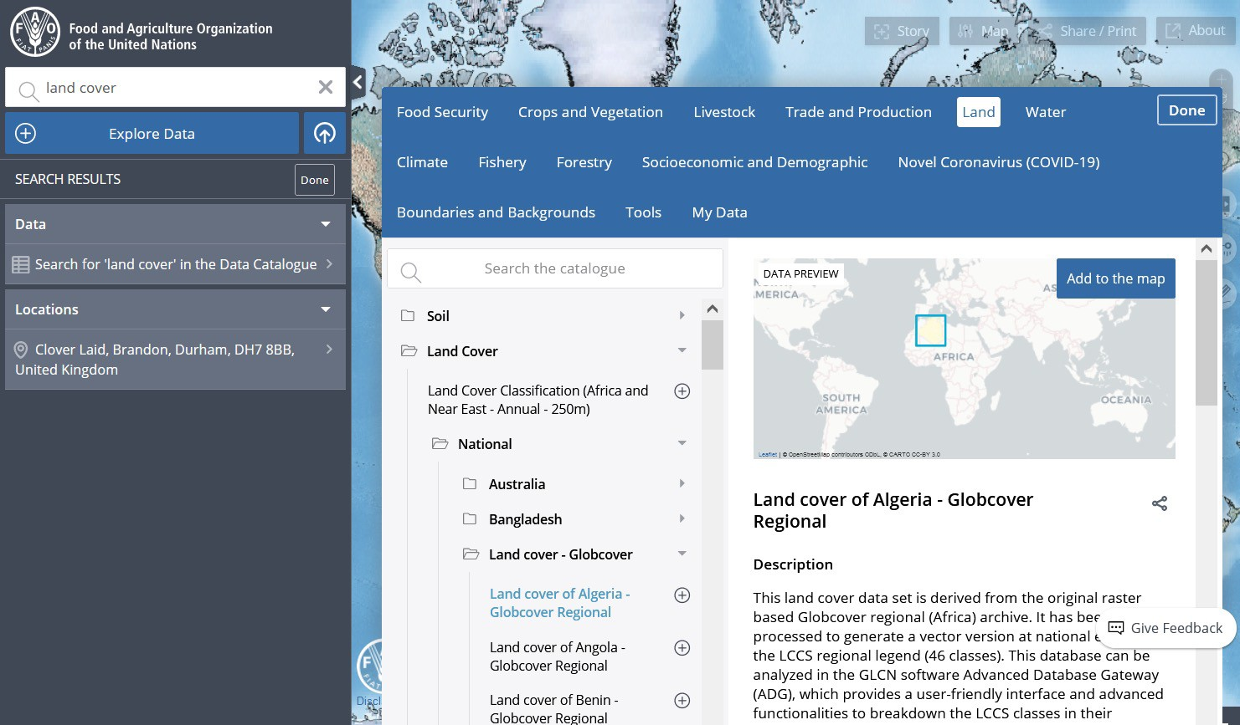
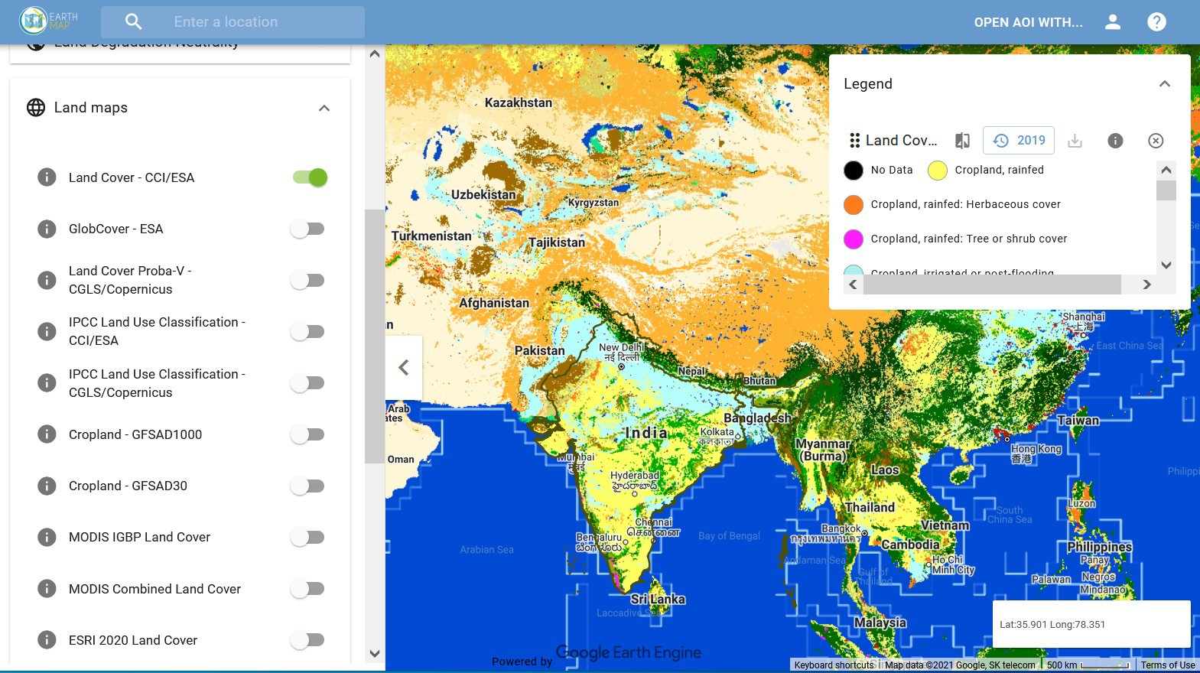
Food and Agriculture Organization
Hand-in-Hand Geospatial Platform
Earth Map
https://data.apps.fao.org
https://earthmap.org
Global

Slide 15
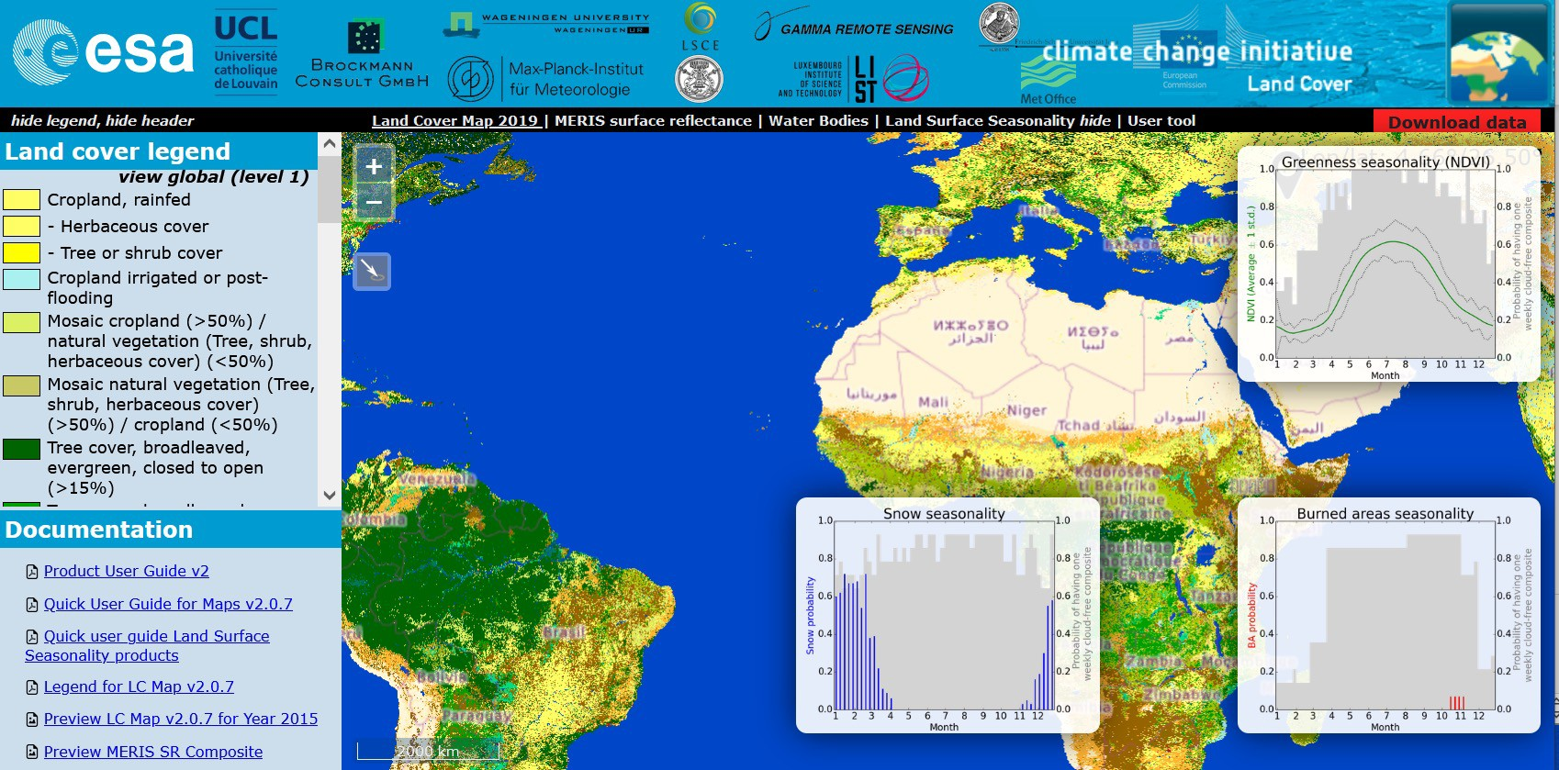
ESA Climate Change Initiative Land Cover
http://www.esa-landcover-cci.org
Annual global land cover time series from 1992 – 2019
Spatial Resolution: 300 m
Remote Sensing Sources:
" NOAA AVHRR
" SPOT
" ENVISAT
" PROBA-V
22 land cover classes based on the UN Land Cover Classification System
Visualize and download with the CCI Land Cover viewer: http://maps.elie.ucl.ac.be/CCI/viewer/
Global

Slide 16
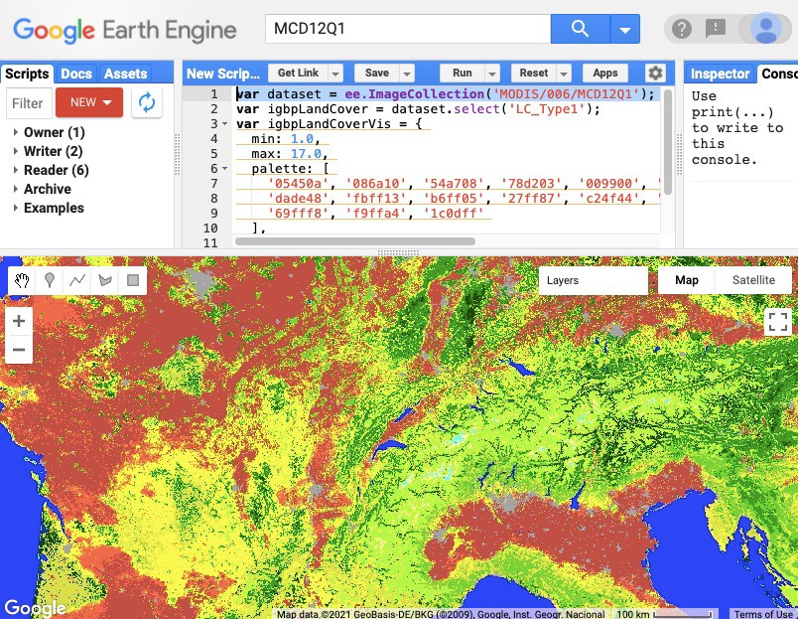
Create Your Own Land Cover Map
Land cover classification is the process of grouping spectral classes and assigning them informational class names.
Spectral Classes:
" Groups of pixels that are uniform with respect to their pixel values in several spectral bands.
Informational Classes:
" Categories of interest to users of the data (like water, forest, urban, agriculture, etc.).
Previous ARSET trainings:
" Land Cover Classification with Satellite Imagery
" Accuracy Assessment of a Land Cover Classification
" Using Google Earth Engine for Land Monitoring Applications
Annual land cover. Credit: GEE Developers

Slide 17
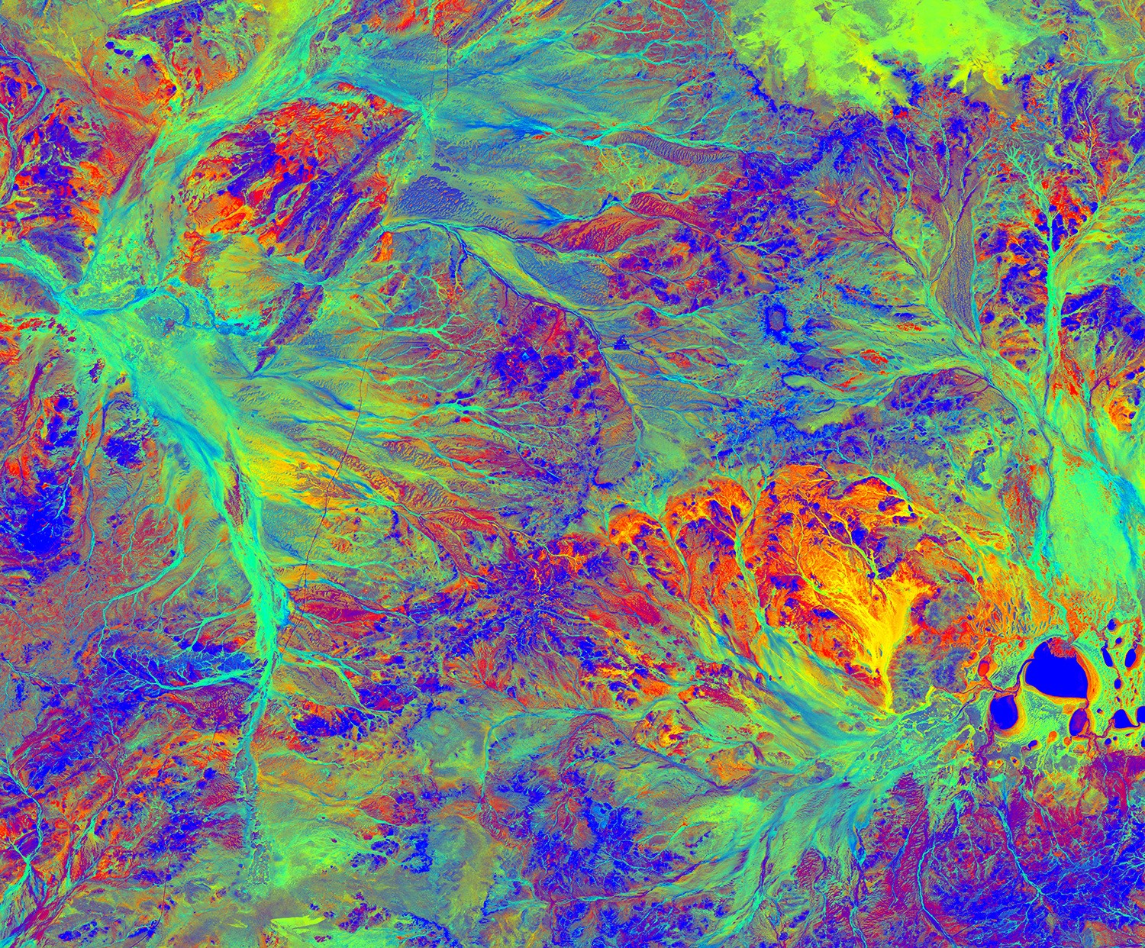
Fractional Cover (FC)
Estimation of the proportion of an area that is covered by each member of a pre-defined set of vegetation or land cover types
Requires conducting a land cover classification
Limitations for FC estimates in remote sensing:
" Spatial resolution (one value per pixel or need for spectral unmixing techniques)
" Errors in classification will propagate into FC estimates.
" Requires hyperspectral data for vegetation species distinctions
Fractional Cover (FC) from Australia: Green (leaves, grass, and growing crops), brown (branches, dry grass or hay, and dead leaf litter), and bare ground (soil or rock). Image Credit: Digital Earth Australia

Slide 18
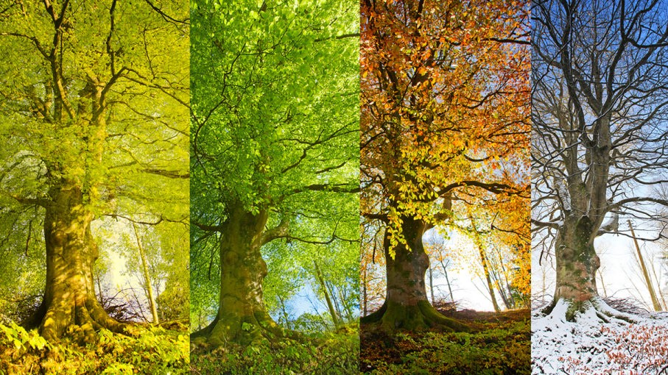
Land Surface Phenology (LSP)
Use of satellites and sensors to track seasonal patterns in vegetated land surfaces
" Regular monitoring of the entire global land surface
" Gather information on entire ecosystems: broad scale trends
" Timing of seasonal patterns related to day length, temperature, and precipitation patterns
" Impacts on species distributions
Useful when linked to ground observation networks
See previous ARSET training on Phenology: https://appliedsciences.nasa.gov/join- mission/training/english/arset-understanding- phenology-remote-sensing
Seasonal cycle of a tree, Image Credit: USGS/NPN)

Slide 19
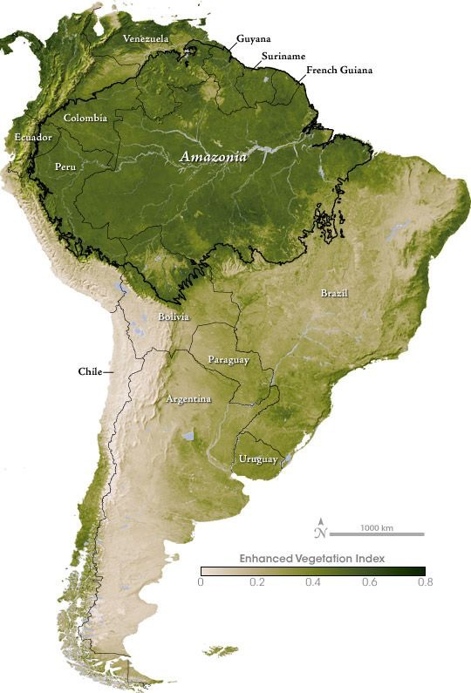
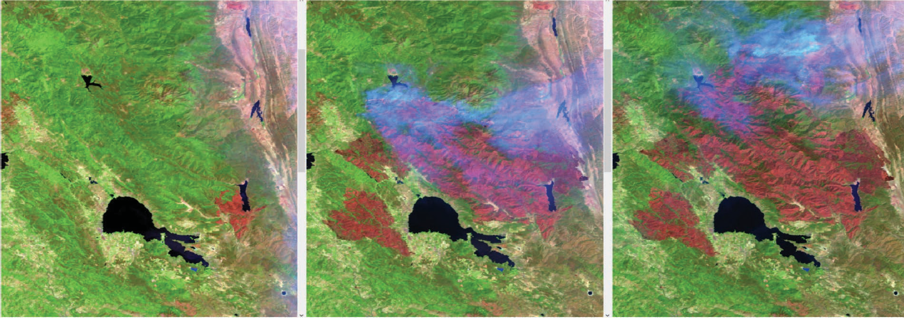
Vegetation Indices
Normalized Difference Vegetation Index (NDVI)
Enhanced Vegetation Index (EVI)
Normalized Difference Moisture Index (NDMI)
Normalized Burn Ratio (NBR)
And many more!
EVI in South America
July 26
Aug 11
Mendocino Complex Fires, 2018
Aug 27
NASA’s Applied Remote Sensing Training Program
26

Slide 20
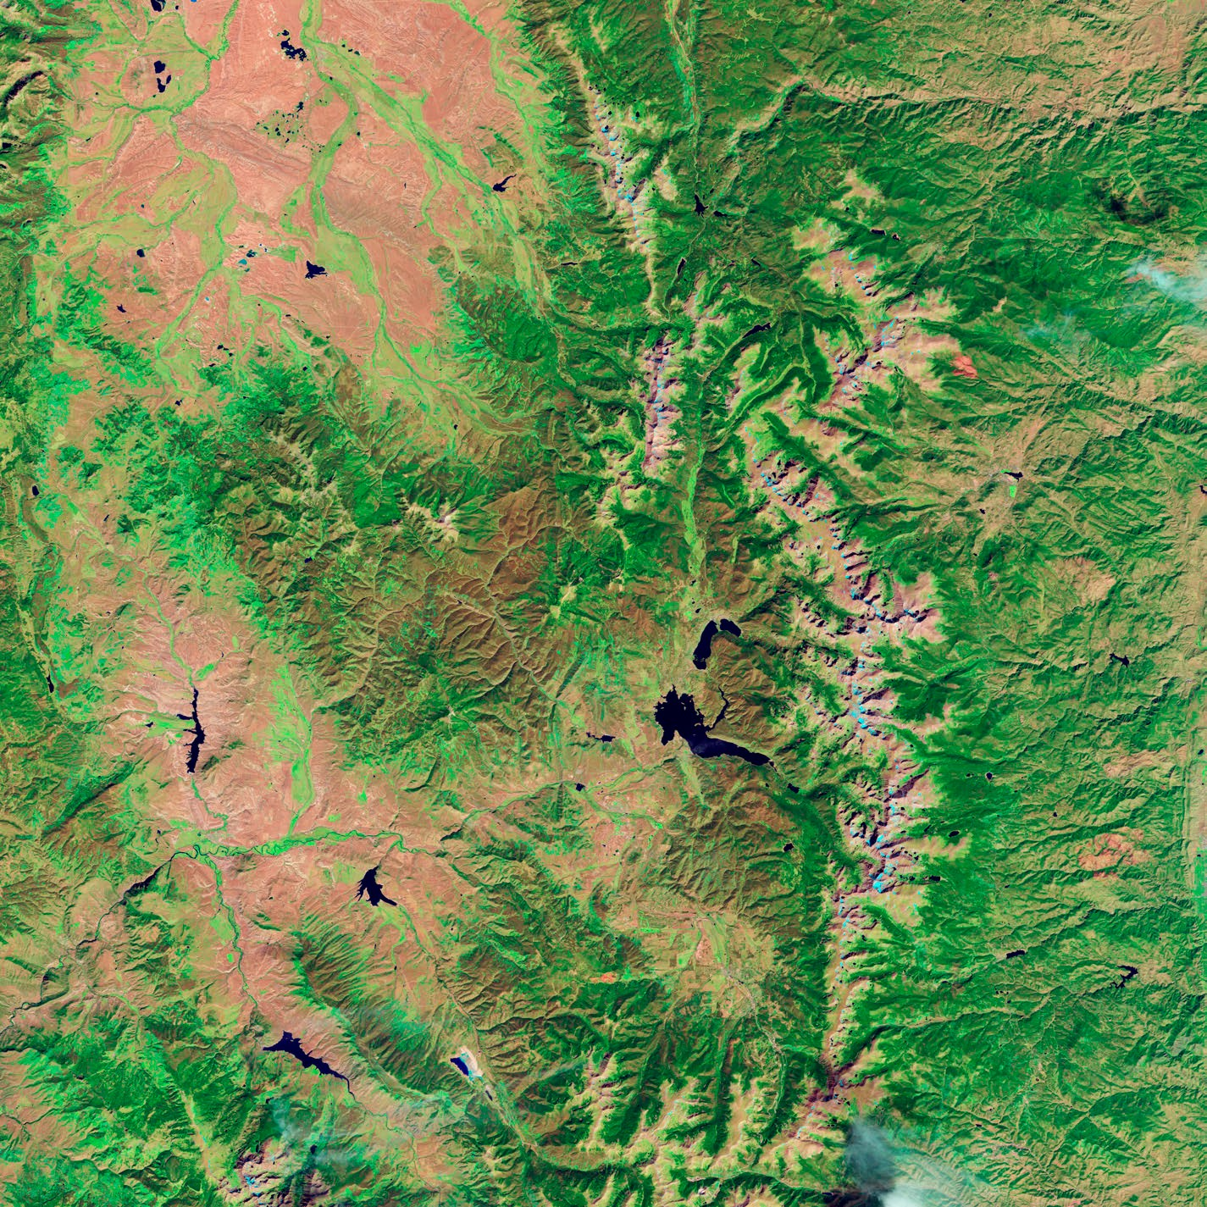
Tree Mortality/Vegetation Disturbance
Change Detection and Time Series Analysis for:
" Large-scale mortality or disturbance " Forest fragmentation and succession " Changes to habitat connectivity
Tools:
" Global Forest Watch
" USDA Insect and Disease Survey
" Landtrendr for Google Earth Engine
" And many more!
Previous ARSET trainings:
" Google Earth Engine for Land Monitoring Applications
" Investigating Time Series of Satellite Imagery
" Change Detection for Land Cover Mapping
Landsat imagery of bark beetle epidemic in Lodgepole pine forests in Colorado. The top image was acquired in September 2005 and the bottom image in September 2011.

Slide 21
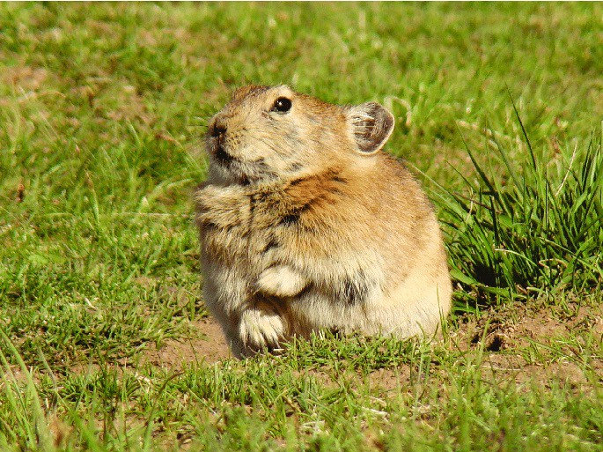
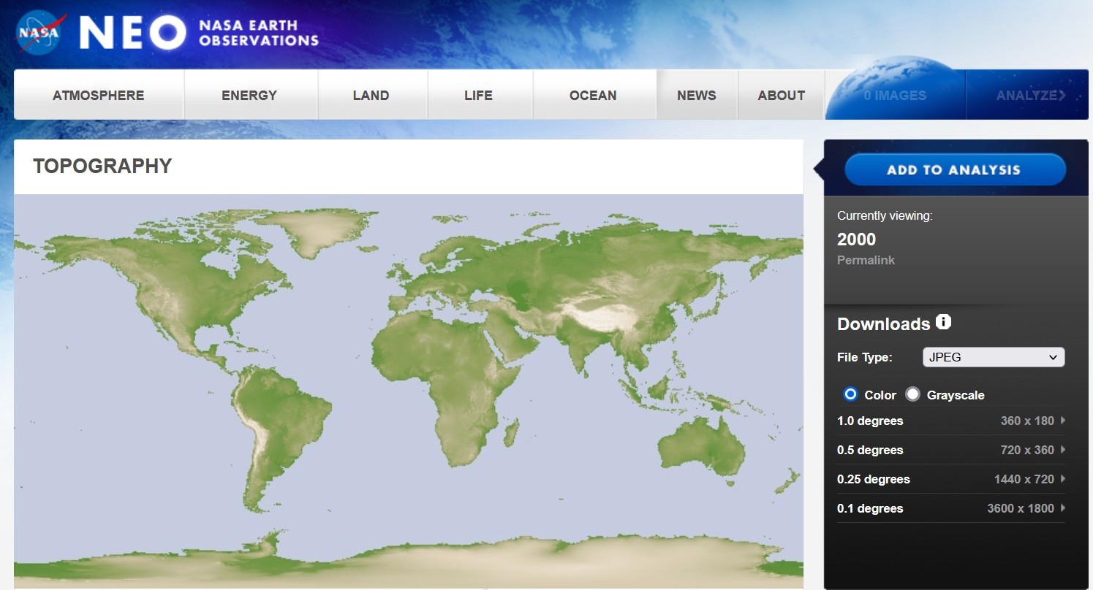
Topography
The Shuttle Radar Topography Mission (SRTM)
" Topographic (elevation) data of Earth's surface
" SRTM used the technique of interferometry flown onboard the Space Shuttle Endeavour
" Launched in February 2000
" 30 m and 90 m spatial resolution
Plateau Pika, Image Credit: Smith et al, 2018
Useful for ecosystem analysis and predictions of where specific plant and animal species exist
Data Access: NASA Earth Observations (NEO): https://neo.sci.gsfc.nasa.gov/view.p hp?datasetId=SRTM_RAMP2_TOPO
NASA NEO
for
topography data

Slide 22
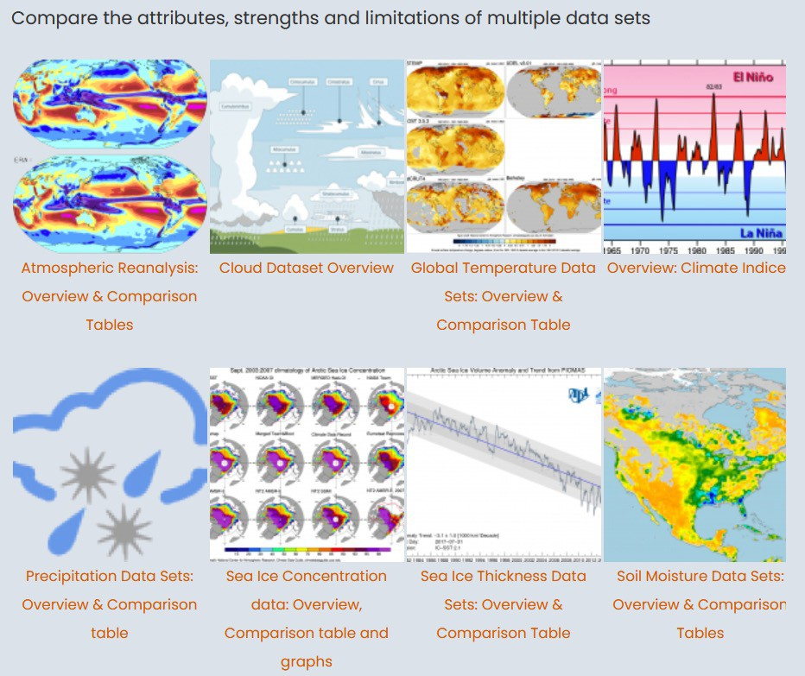
Gridded Climate Data Resources
NOAA Physical Sciences Laboratory
" https://psl.noaa.gov/data/grid ded/
NCAR Climate Data Guide
" https://climatedataguide.ucar. edu/
PRISM Climate Data
" https://prism.oregonstate.edu/
gridMET
" http://www.climatologylab.org
/gridmet.html
NCAR Climate Data Guide

Slide 23
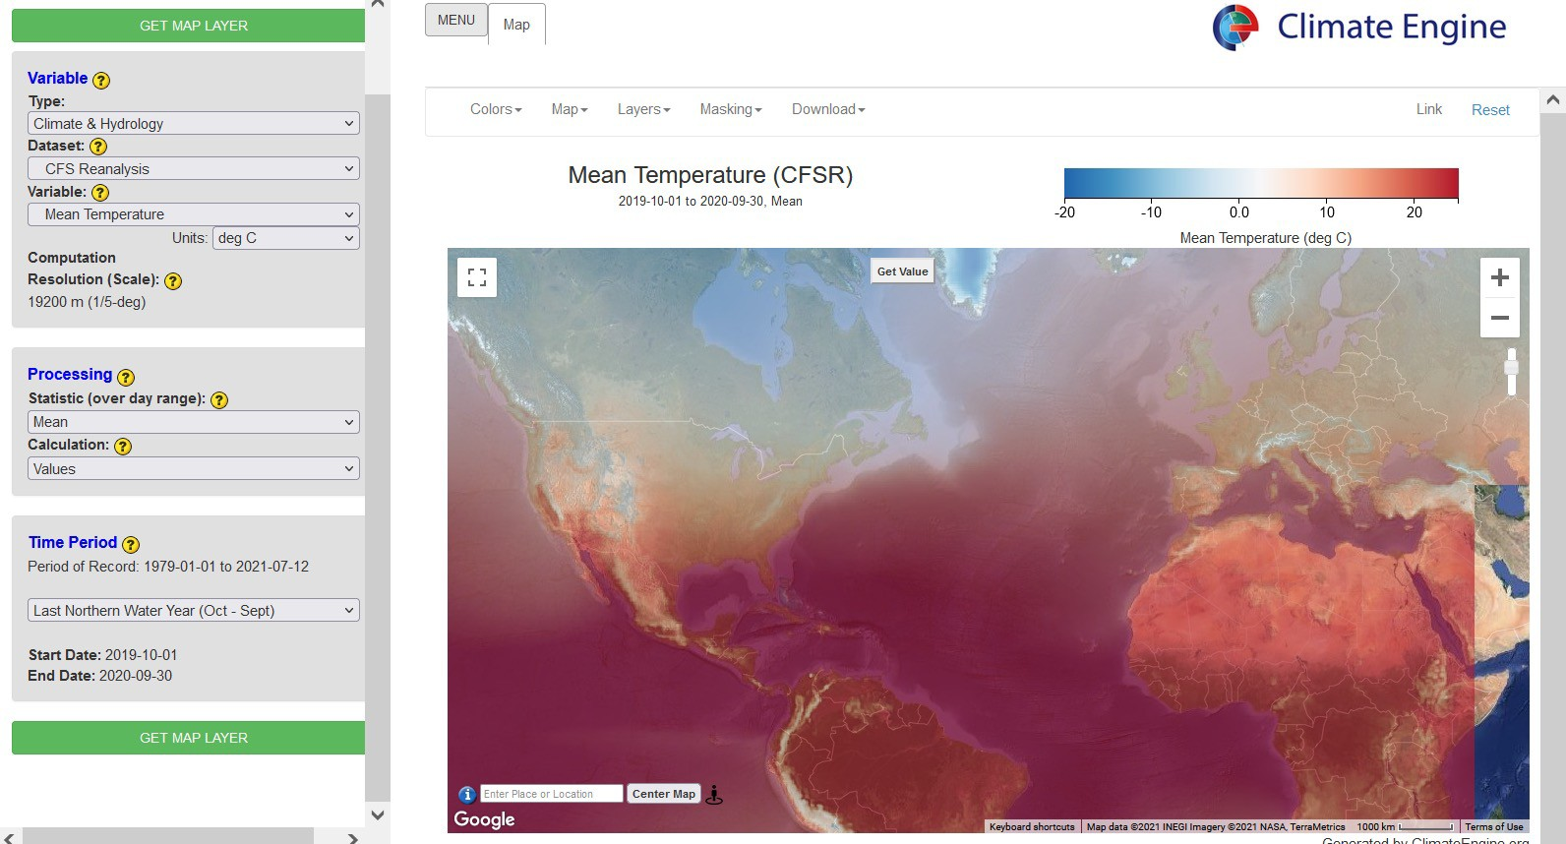
Gridded Climate Data with Climate Engine
http://climateengine.org/

Slide 24
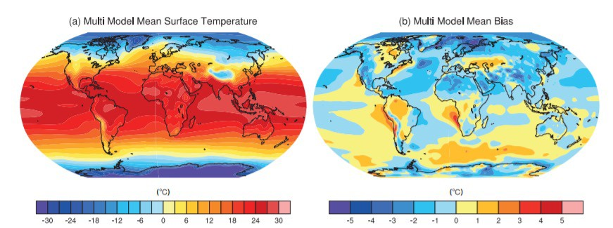
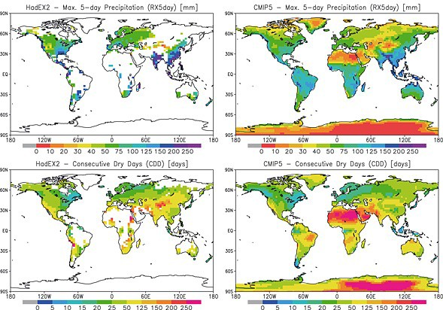
Future Scenarios: Global Climate Models
Modeling future species distributions can be challenging.
The use of multiple climate models and downscaling techniques is often necessary.
Uncertainties across models and variables can propagate.
See previous ARSET training on Scenario Modeling (Part 2 in particular) for more information:
Flato et al. 2013. Evaluation of climate models. Ch. 9 of IPCC Physical Science Basis
" https://appliedsciences.nasa.gov/ join-mission/training/english/arset- introduction-remote-sensing- scenario-based-ecoforecasting
Sillmann et al. 2013 Journal of Geophysical Research: Atmospheres

Slide 25
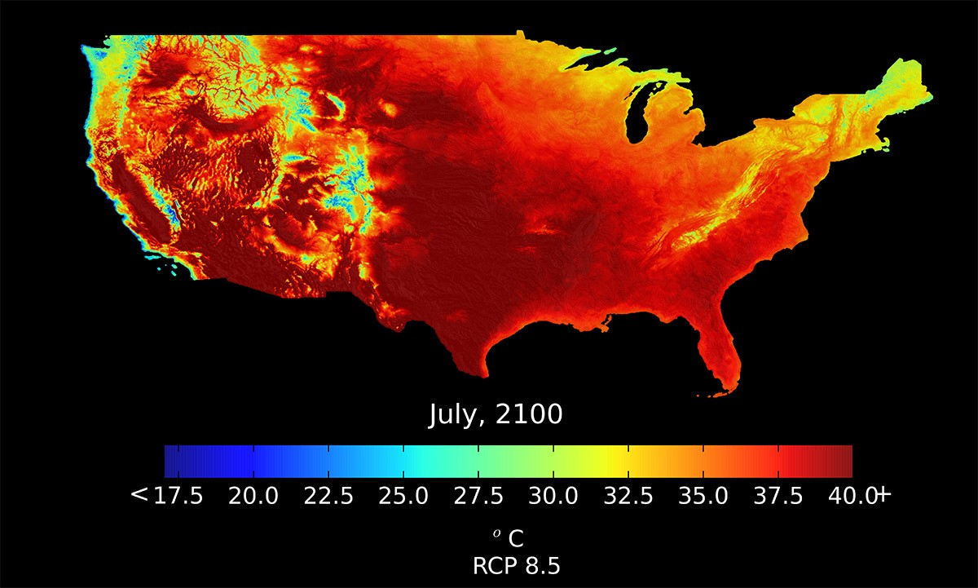
Climate Models with the NASA Earth Exchange (NEX)
Downscaled Climate Projections (NEX- DCP30)
" Conterminous United States
" Coupled Model Intercomparison Project Phase 5 (CMIP5)
" Four greenhouse gas emissions scenarios known as Representative Concentration Pathways (RCPs)
" Projections from 33 models and ensemble statistics
" https://www.nccs.nasa.gov/service s/data-collections/land-based- products/nex-dcp30
The NEX-DCP30 predicted monthly mean of the daily maximum near-surface air temperature for July 2100, downscaled to 800 meters. The image data is based on the Representative Concentration Pathway scenario 8.5 (RCP8.5). Image Credit: NEX

Slide 26
Occurrence Data

Slide 27
ARSET Contacts for this training content
Trainers:
" Juan Torres-Pérez: juan.l.torresperez@nasa.gov
" Amber McCullum: amberjean.mccullum@nasa.gov
" Zach Bengtsson: bengtsson@baeri.org
Follow us on Twitter @NASAARSET
Training Webpage:
" https://appliedsciences.nasa.gov/join-mission/training/english/arset-species- distribution-modeling-remote-sensing
ARSET Website:
" https://appliedsciences.nasa.gov/what-we-do/capacity-building/arset

